Slide 1

Security Standards Organizations

Slide 2
Agenda
Internet Corporation for Assigned Names and Numbers (ICANN)
International Organization for Standardization (ISO)
Consultative Committee For Telephone and Telegraphy (CCITT)
International Telecommunication Union (ITU)
American National Standards Institute(ANSI)
Institute Of Electronics and Electrical Engineers(IEEE)
Electronic Industries Association

Slide 3
The Internet Corporation for Assigned Names and Numbers
The Internet Corporation for Assigned Names and Numbers is a non-profit responsible for the global coordination of the Internet's unique identifier and its stable operation and safe profit organization.
There are two primary goals for translation at ICANN:
1. Make information about ICANN and its work accessible to those who speak languages other than English in ways that enhance participation
2. Make ICANN more effective as a global organization. ICANN's translations are available in the six United Nations languages –Arabic, Chinese (Simplified), English, French, Russian and Spanish – where appropriate.

Slide 4
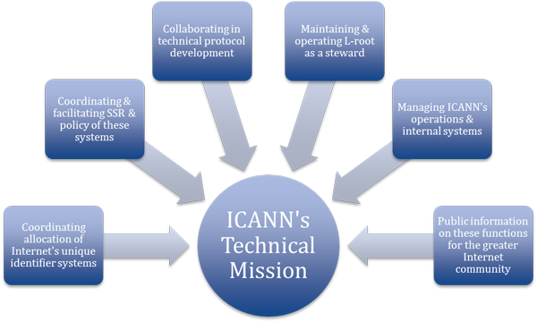

Slide 5
To reach another person on the Internet you have to type an address into your computer ICANN coordinates these unique identifiers across the world.
Without that coordination we wouldn't have one global Internet.
ICANN was formed in 1998. It is a not-for-profit partnership of people from all over the world dedicated to keeping the Internet secure, stable and interoperable.
ICANN doesn’t control content on the Internet. It cannot stop spam and it doesn’t deal with access to the Internet

Slide 6
What is the domain name system?
The domain name system, or DNS, is a system designed to make the Internet accessible to human beings.
The main way computers that make up the Internet find one another is through a series of numbers.
The end result is that ICANN’s website can be found at “icann.org” rather than “192.0.32.7” – which is how computers on the network know it.
This change will then be recognized by the entire Internet within 48 hours thanks to the constantly updating DNS infrastructure.
The DNS provides an addressing system for the Internet so people can find particular websites.

Slide 7
What about root servers?
Root servers are a different case again. There are 13 root servers – or, more accurately, there are 13 IP addresses on the Internet where root servers can be found.
These servers all store a copy of the same file which acts as the main index to the Internet’s address books.
In reality, the root servers are consulted fairly infrequently .
The operators of the root servers remain largely autonomous, but at the same time work with one another and with ICANN to make sure the system stays up-to-date with the Internet’s advances and changes.

Slide 8
How is ICANN structured?
The organizations that deal with IP addresses
The organizations that deal with domain names
The managers of country code top-level domains

Slide 9



Slide 10

We are an independent, non-governmental organization.
We are a global network of national standards bodies with one member per country.
Our job is to make International Standards.
We are coordinated by a Central Secretariat in Geneva, Switzerland.
We are not for profit : selling our standards allows us to finance their development in a neutral environment, to maintain them and to make new ones.

Slide 11

ISO provides a platform for developing practical tools through common understanding and cooperation with all stakeholders.
We are ISO,
163* members
21350*
International standards
100
New standards each month
238*
Technical committees

Slide 12
Examples of standards in our everyday life.
Freight containers
Credit cards
Codes for countries and Currencies
Telephone networks

Slide 13

How do you benefit from International Standards ?
Industry :
Become more competitive by offering products and services that are accepted globally
Enter new markets easily.
Raise profits by offering products with increased quality, compatibility and safety.
Reduce costs by not reinventing the wheel and using available resources better.
Benefit from the knowledge and best practice of leading experts around the world.

Slide 14
Regulators :
Harmonize regulations across countries to boost global trade
Increase credibility and trust throughout the supply chain.
Make it easier for countries to outsource and specialize.
Society :
Wider choice of safe and reliable products and services at competitive prices.
Best practice and concerted action at the organizational level to practically address global challenges like climate change and sustainability.

Slide 15
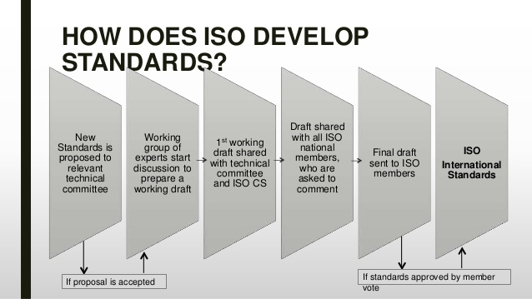
How does ISO works?

Slide 16
CCITT Constative Committee for International Telegraphy
The CCITT is part of the ITU (International Telegraph Union), which has a history that stretches back to 1865.
In that year, 20 countries agreed to standardize telegraph networks. The ITU was set up as part of the agreement to work on subsequent amendments.
In 1934, the union changed its name to the International Telecommunication Union to more properly define its role in all forms of communication, including wire, radio, optical, and electromagnetic systems.

Slide 17


ITU is the United Nations specialized agency for information communication technologies – ICTs.
ITU is committed to connecting all the world's people – wherever
they live and whatever their means.
Through our work, we protect and support everyone's fundamental
right to communicate.
Membership: Contact. Commit. Connect. Become a member of ITU

Slide 18

An organization based on public-private partnership
since its inception
ITU currently has a membership of 193 countries and
almost 800 private-sector entities and academic
institutions.
Our Vision: Committed to connecting the world
Virtually every facet of modern life – in business, culture or entertainment, at work and at home
– depends on information and communication technologies (ICTs).

Slide 19
Our Vision, Mission and Strategic Goals
Vision:
An information society, empowered by the interconnected world, where telecommunication/ information and communication technologies enable and accelerate social, economic and environmentally sustainable growth and development for everyone.
Mission:
To promote, facilitate and foster affordable and universal access to telecommunication/ information and communication technology networks, services and applications and their use for social, economic and environmentally sustainable growth and development.

Slide 20



Our Strategic Goals
Goal 1: Growth
Enable and foster access to and increased use
of telecommunication/ICT
Goal 2: Inclusiveness
Bridge the digital divide and provide broadband for all

Slide 21


Goal 3: Sustainability
Manage challenges resulting from telecommunication/ICT development
Goal 4: Innovation and Partnership
Lead, improve and adapt to the changing telecommunication/ICT environment

Slide 22
Radio communication Sector (ITU-R)
The ITU-R hosts several study groups, to discuss technical and policy-related issues such as spectrum management, radiowave propagation, fixed-satellite service, broadcasting services and other satellite services.
The international Radio Regulations are negotiated at World Radio.
They also contain the international Table of Allocations for bands of frequencies to be used for providing specific radio communication services Conferences and are formed by the Final Acts of WRCs.

Slide 23

Development Sector (ITU-D)
The mission of ITU-D is to raise the level of awareness of decision-makers concerning the role of telecommunications in national economic and social development
The WTDC is designated to "serve as a forum for the study of
policy, organizational, operational, regulatory, technical and
financial questions" related to telecommunications development.
Study and issue Recommendations on radio communication issues;
Effect allocation of bands of the radio-frequency spectrum, the
allotment of radio frequencies and the registration of radio
frequency.

Slide 24

American National Standards Institute

Slide 25
Abbreviation ANSI
Formation October 19, 1918 (98 years ago)
Purpose National standards
Headquarters Washington, D.C.,United States
Membership 125,000 companies and 3.5
million professionals
Official language English
Website www.ansi.org

Slide 26

The American National Standards Institute is a private non-profit organization that oversees the development of voluntary consensus standards for products, services, processes, systems, and personnel in the United States.
History
ANSI was originally formed in 1918, when five engineering societies and three government agencies founded the American Engineering Standards Committee (AESC)
Members
ANSI's members are government agencies, organizations, corporations, academic and international bodies, and individuals. In total, the Institute represents the interests of more than 125,000 companies and 3.5 million professionals.

Slide 27

Process
Though ANSI itself does not develop standards, the Institute oversees the development and use of standards by accrediting the procedures of standards developing organizations.
The American National Standards process involves:
consensus by a group that is open to representatives from all interested parties
broad-based public review and comment on draft standards
consideration of and response to comments
incorporation of submitted changes that meet the same consensus requirements into a draft standard
availability of an appeal by any participant alleging that these principles were not respected during the standards-development process.

Slide 28


Institute of Electrical and Electronics Engineers

Slide 29
The Institute of Electrical and Electronics Engineers (IEEE, pronounced "I triple E") is a professional association with its corporate office in New York City and its operations center in Piscataway, New Jersey.
Today, it is the world's largest association of technical professionals with more than 420,000 members in over 160 countries around the world.
Its objectives are the educational and technical advancement of electrical and electronic engineering, telecommunications, computer engineering and allied disciplines.

Slide 30

IEEE members can access information on local events and activities
by signing in to my IEEE, the members' personalized gateway to
IEEE membership.
Access individual Society memberships and subscriptions
Connect with local IEEE Sections and volunteer leadership
Find upcoming conferences
Learn more about individual benefits
Read the latest news from IEEE, IEEE Spectrum, IEEE Standards
News
Women in Engineering (WIE)
IEEE Women in Engineering (WIE) is one of the largest international
professional organizations dedicated to promoting women
engineers and scientists, and inspiring girls around the world to
follow their academic interests in a career in engineering.

Slide 31
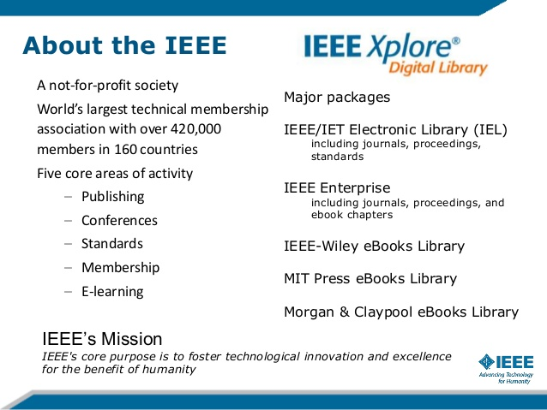

Slide 32
Thank You

